Slide 1

Default Prevention:
A Proactive Approach to Managing your Cohort Default Rate

Slide 2
EXPECTATIONS

Slide 3

Satisfied with your rate?

Slide 4

Changing from the two year rate to
the three year rate calculation

Slide 5
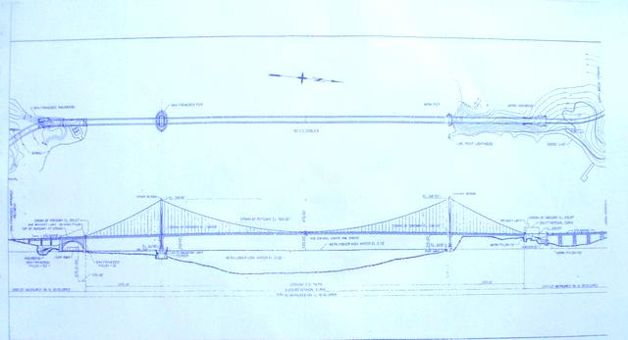
Who needs/wants a plan?

Slide 7

What’s in a plan
  Early Stages of Enrollment
  Late Stages of Enrollment
  After Students Leave School
  Enhanced Entrance and Exit Counseling
  Tools and Activities for Schools

Slide 8

Core elements of a Default Management Plan
1. Entrance Counseling
2. Financial Literacy for Borrowers
3. Communication Across Campus
4. Exit Counseling
5. Timely and Accurate Enrollment Reporting
6. NSLDS Date Entered Repayment (DER) Report
7. Late Stage Delinquency Assistance (LSDA)
8. Loan Record Detail Report (LRDR)
Data Review
9. Analyze Defaulted Loan Data to
Identify Defaulter Characteristics

Slide 9

Implementation

Slide 10


